Slide 1
Retirement Income: IRAs and Pensions
New Jersey Slides
Tax Year 2018
Notes:
1

Slide 2
Traditional IRA – NJ Rules
Contributions to IRA are not deductible in the year made
Therefore, contributions may not be taxable when distributed
Earnings accumulate tax deferred, but earnings taxed when distributed

Slide 3
Roth IRA – NJ Rules
Rules for taxability of distributions are the same for NJ

Slide 4
401k Plans – NJ Rules
Contributions are pre tax in NJ starting 1/1/84
Distributions taxable in the year received

Slide 5
NJ Retirement Income Topics
Special topics relating to NJ tax law on retirement income to be discussed on subsequent slides
Military pensions
NJ 1040 Pensions/Annuities/IRA Withdrawals (NJ 1040 Lines 19a/19b)
Rules on taxability of NJ retirement income
NJ IRA Worksheet for IRAs, 403b, 457b, Thrift Savings Plan
NJ contributory pensions
3-year rule for pensions
NJ pension exclusion
NJ other retirement income exclusions
Disability pension on NJ return
Public safety officer pension

Slide 6
Military Pension on NJ Return
Military pensions are not taxable in NJ
Amount of military pension will flow through from entry of 1099-R in Federal section, so must tell TaxSlayer to subtract this from NJ taxable income
Capture the amount of the military pension in NJ Checklist Income Subject to Tax section for later entry in TaxSlayer State section

Slide 7
NJ 1040 Line 20a and 20b Pensions/Annuities/IRA Withdrawals
NJ 1040 includes all distribution amounts from pensions, annuities, and IRAs on Line 20a and 20b
NJ does not have separate lines for IRAs vs. pensions/annuities as Federal 1040 does
NJ 1040 Line 20a includes all the taxable distribution amounts
NJ 1040 Line 20b includes all excludable amounts
Total of Lines 20a + 20b should equal the total of all 1099-R Box 1s
Does not include 1099-Rs for distributions that are totally tax-exempt, such as military pensions, disability pensions for persons under 65, Railroad Retirement Tier 2 pensions. These items do not appear on NJ 1040 at all

Slide 8
NJ 1040 Line 20b – Excludable Pensions, Annuities, & IRA Withdrawals
NJ 1040 Line 20b is used to show the excludable portion of any distribution you received from a contributory pension, annuity, or IRA. This is the amount that represents your previously taxed contributions to the plan
To determine the excludable amount to enter, add together:
Non-taxable amounts calculated on the Simplified General Rule Worksheet
The difference amount anytime the 1099-R Box 1 (gross distribution) is different than Box 2a (taxable amount)

Slide 9
NJ 1040 Line 20b – Excludable Pensions, Annuities, & IRA Withdrawals – cont’d
The full amount received when using the Three-Year Rule until all of the contributions are recovered
Do not include pensions that are not taxed in NJ such as military pensions, disability pensions under 65, and Railroad Retirement Tier 2 pensions
Refer to TaxPrep4Free.org “NJ Special Handling” document on Preparer page for details

Slide 10
Rules on Taxability Of Retirement Income - NJ
Contribution | Contribution Made with After-NJ-Tax Money | Taxable on Distribution
Employer contributions | N/A | YES
Employee contributions paid with pre-tax dollars to 401K | NO | YES
Employee contributions paid with after-tax dollars (including IRA) | YES | NO
Earnings on both employer & employee contributions | N/A | YES

Slide 11
IRAs, 403b, 457b, Thrift Savings Plans
Distributions from IRAs, 403b, 457b, and Thrift Savings Plans (TSPs) are taxed in NJ except for the portion that represents taxpayer contributions
Contributions were made with after-NJ-tax money, so not taxed upon distribution
To determine NJ taxability amount of any of these distributions, the portion of the distribution that represents taxpayer contributions is allocated over expected number of distribution years

Slide 12
IRAs, 403b, 457b, Thrift Savings Plans – cont’d
Taxpayer must know total contributions
May be able to get info for some of these plans from NJ Division of Pensions and Benefits or from plan administrator. Taxpayers would have to know IRA contributions from their own records
Use NJ IRA Worksheet on TaxPrep4Free.org to determine the taxable and nontaxable amounts (if contributions are known)

Slide 13
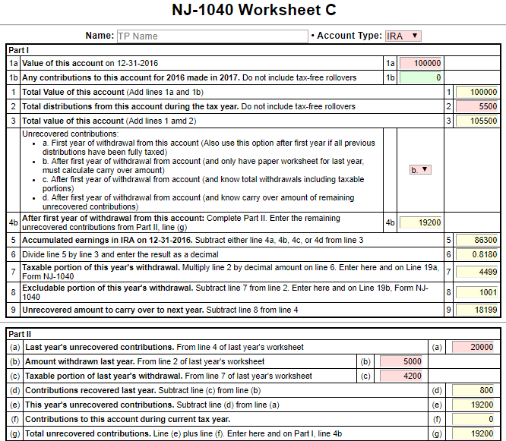
NJ IRA Worksheet on TaxPrep4Free.org to determine Taxable and Nontaxable Portions of IRAs, 403b, 457b, Thrift Savings Plans
Enter as adjustments to Lines
20a and 20b on NJ Checklist

Slide 14
NJ Contributory Pensions
A retirement plan in which employee contributes a portion of base salary into pension plan. Employer may make contributions also
We see a lot of these for former NJ state and municipality workers
At retirement, retiree receives a set amount each month
Taxability of distribution depends on whether contributions were taxed when made

Slide 15
NJ Contributory Pensions – cont’d
Federal tax treatment
Employee contributions made prior to 1/1/87 were made with after-tax money that was included in W-2 wages when contributed. Contributions after 1/1/87 were made with pre-tax money and not included in W-2 wages
Optional pension membership credit purchased before 2002 were also after-tax
At distribution, the pre-tax contributions plus employer contributions and earnings are taxable
After-tax contributions can be recovered evenly over taxpayer’s expected lifetime or combined lifetime with spouse (if joint and survivor annuity)

Slide 16
NJ Contributory Pensions – cont’d
Federal tax treatment – cont’d
Federal after-tax contributions are shown on 1099-R in Box 9b. Usually current year’s excludable amount is shown in Box 5, and then reflected in the taxable amount shown in Box 2a
If taxable amount is not shown in Box 2a, use the Simplified General Rule Worksheet in TaxSlayer or the Bogart Annuity Calculator on TaxPrep4Free.org to determine the taxable amount, based on the amount in Box 9b

Slide 17
NJ Contributory Pensions – cont’d
NJ tax treatment
All employee contributions are made with after-NJ-tax money that is included in W-2 NJ State Wages when contributed
Therefore, all employee contributions are tax-exempt upon distribution. Only employer contributions and earnings are taxable for NJ
To determine the NJ taxable amount, must use total employee contributions amount, not the amount shown in Box 9b
Insert total employee contributions in TaxSlayer Simplified General Rule Worksheet or Bogart Annuity Calculator to determine the NJ taxable and non-taxable amounts of the distribution
See Special Topics document “Contributory Pensions” of TaxPrep4Free.org for more details

Slide 18
Example of NJ Contributory Pension
1099-R Box 1 Gross Distribution $22,000
1099-R Taxable Amount Blank
1099-R Box 9b Employee Contributions $2,000
(Federal after-tax contributions amount)
Total Employee Pension Contributions
(provided by pension administrator or client) $50,000
Using Simplified General Rule Worksheet or Bogart Annuity Calculator:
Using Federal after-tax contributions of $2,000, the Federal taxable amount of the distribution is $21,908
Using total employee contributions of $50,000, the NJ taxable amount of the distribution is $19,692
See Special Topics document “NJ Contributory Pension” on TaxPrep4Free.org Preparer Page for help calculating the correct adjustment amounts for NJ 1040 Lines20a and 20b. Capture on the NJ Checklist for later entry in TaxSlayer State section

Slide 19
NJ 3-Year Rule for Pensions Qualifications
May use NJ 3-Year Rule if:
Both you and employer contributed to plan
Will recover your contributions within 36 months of 1st distribution from plan
Must be just starting to collect pension
May exclude all pension distributions from income until distributions = contributions
If pension started in middle of year, could be partially taxable in last year of exclusion
Since Federal taxable amount flows through to NJ 1040 Line 20a, capture the amount that should be tax exempt under the 3-year rule in NJ Checklist Income Subject to Tax section for later entry in TaxSlayer State section

Slide 20
NJ 3-Year Rule for Pensions Qualifications
Once all contributions are recovered under 3-year rule, all of pension distributions will be taxable for NJ. Capture the amount of pension income to be added back into taxable NJ pension income on Line 20a in NJ Checklist Income Subject to Tax section for later entry in TaxSlayer State section

Slide 21
NJ Pension Exclusion Qualifications
You &/or spouse/CU partner 62 years+ or blind or disabled (according to SSA guidelines) on last day of year
If only one partner qualifies, can still claim up to maximum pension exclusion. However, only retirement income of qualified partner can be excluded
Capture the fact that taxpayer and/or spouse is disabled according to SSA guidelines in NJ Checklist Subtractions from Income section for later entry in the State section
Total income from NJ 1040 Line 27 $100K or less

Slide 22
NJ Pension Exclusion Annual Amounts
Based on filing status:
$60,000 (2018) – MFJ
$45,000 (2018) – Single, HOH, QW
$30,000 (2018) – MFS
Maximum exclusion cannot exceed total Pension, Annuity & IRA Withdrawal amount on NJ 1040 Line 20a

Slide 23
Other Retirement Income Exclusions - NJ1040 Line 28b
Two Parts to Other Retirement Income Exclusions
Unclaimed portion of your Pension Exclusion (NJ 1040 line 28a)
Special exclusion for taxpayers who are unable to receive SS or RR benefits
Each part has different eligibility requirements

Slide 24
Other Retirement Income Exclusions: Unclaimed Pension Exclusion
Did not use maximum Pension Exclusion
Taxpayer &/or spouse/CU partner 62 years+
Total income from NJ 1040 Line 27 $100K or less
Income from wages, net profit from business, partnership, S corp. income </= $3K
Amount will be maximum pension exclusion minus pension exclusion claimed on NJ 1040 Line 28a

Slide 25
NJ Other Retirement Income Exclusions: For Taxpayers Unable to Receive SS/RR Benefits
Not related to Pension Exclusion & may claim whether or not you use maximum Pension Exclusion
Exclusion amounts $6K – MFJ, HOH, QW; $3K – Single, MFS
You &/or spouse/CU partner 62 years+
Unable to receive SS/RR benefits, but would have been eligible for benefits had you fully participated in either program
Must answer questions under Pension Exclusion in State section \ Edit \ Enter Myself \ Subtractions from Income for TaxSlayer to determine eligibility

Slide 26
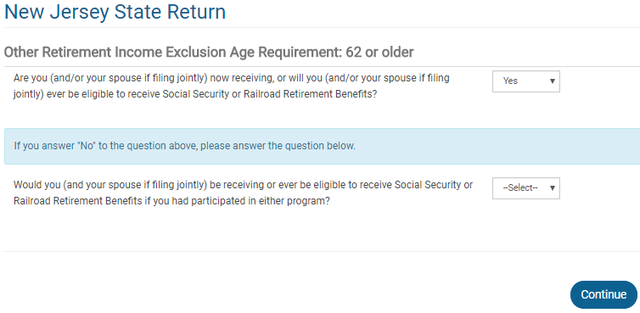
TS – Additional Questions for Other Retirement Income Exclusion
Questions to determine eligibility for
Other Retirement Income exclusion

Slide 27
Railroad Retirement Benefits Tier 2 (Pension Equivalent)
Railroad Retirement Tier 2 (Pub 575)
Reported on RRB-1099-R - Green Form
Same rules as pensions
RRB-1099-R Pension (not taxable in NJ)
TaxSlayer automatically excludes the railroad retirement pension amount from NJ income

Slide 28
Disability Pension on NJ Return
Disability pension is taxed differently in NJ depending on age of recipient
Recipient under age 65 – disability pension is tax exempt
Recipient age 65 or older – disability pension is treated as a regular pension
Amount of disability pension flows through to NJ pension line 20a from entry of 1099-R in Federal section
Does not matter whether disability pension is treated as pension or wages on the Federal return (i.e. – whether recipient is under or over company minimum retirement age)
If disability should be tax exempt because recipient is under age 65, capture the amount of the disability pension in the NJ Checklist Income Subject to Tax section for entry later in the State section
TaxSlayer does not automatically remove this disability pension from NJ 1040 Line 20a for Pensions

Slide 29
Public Safety Officer Pension
When accident, health or long-term care insurance premiums are deducted directly from pension check, a former Public Safety Officer is allowed up to a $3,000 reduction in taxable income
Enter in Federal section \ Income \ Enter Myself \ IRA/Pension Distributions (1099-R, 1099-SSA)
Do not include the insurance premiums (up to $3,000) in the taxable amount entered in Box 2a
Click on Options under Box 2a to enter the amount of premiums to be excluded from taxable income
Amounts entered as nontaxable cannot also be included on Schedule A as medical expenses

Slide 30
Public Safety Officer Pension
NJ law does not allow exclusion of these premiums and the premiums must be added back
Since premium amounts cannot be excluded from NJ taxable income, they can be claimed as NJ medical expenses (subject to 2% threshold)
Capture premium amount in NJ Checklist Income Subject to Tax and Subtractions from Income sections for later entry in the TaxSlayer State section

